Slide 1
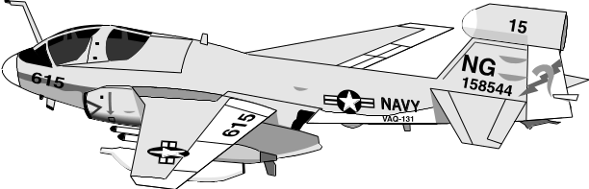
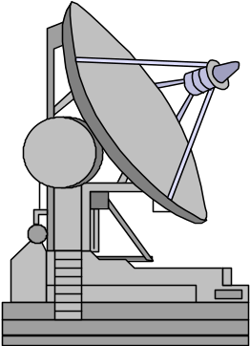
Team Five
Design Exercise
Kelley Thompson
Nam Tran
Steven Maza
Virna Razetto

Slide 2
Test Design Summary – Group # Five
Test Design: 6MMx2Rx2S=36 Operators 1-Way
What Ranges: 3000 5000 7000
Number of Operators? Four
Operators in full factorial model? Yes
Design-Template 14 <number>

Slide 3
Minitab Data Sheet
RMD Mortar D/M Range Operator Kill F50+ Q25 F50 Q25+ D10 D10+
96 F50+ D 5000 1 1 96 112 79 88 112 73
58 F50+ M 7000 2 1 58 112 98 89 111 95
120 F50+ D 3000 3 0 120 112 107 83 136 99
88 F50+ M 5000 4 1 88 96 91 79 96 104
104 F50+ D 7000 2 0 104 116 123 87 104 107
98 F50+ M 3000 3 1 98 91 102 81 139 75
112 Q25 D 5000 4 0
112 Q25 M 7000 1 0
112 Q25 D 3000 3 0
96 Q25 M 5000 4 1
116 Q25 D 7000 2 0
91 Q25 M 3000 2 1
79 F50 D 5000 4 1
98 F50 M 7000 1 1
107 F50 D 3000 2 0
91 F50 M 5000 3 1
123 F50 D 7000 1 0
102 F50 M 3000 2 0
88 Q25+ D 5000 3 1
89 Q25+ M 7000 4 1
83 Q25+ D 3000 4 1
79 Q25+ M 5000 3 1
87 Q25+ D 7000 2 1
81 Q25+ M 3000 1 1
112 D10 D 5000 1 0
111 D10 M 7000 2 0
136 D10 D 3000 3 0
96 D10 M 5000 4 1
104 D10 D 7000 4 0
139 D10 M 3000 3 0
73 D10+ D 5000 2 1
95 D10+ M 7000 1 1
99 D10+ D 3000 1 1
104 D10+ M 5000 2 0
107 D10+ D 7000 3 0
75 D10+ M 3000 4 1
Design-Template 14 <number>
Notes:
Here we included as much of the data set as we could get on the page.

Slide 4
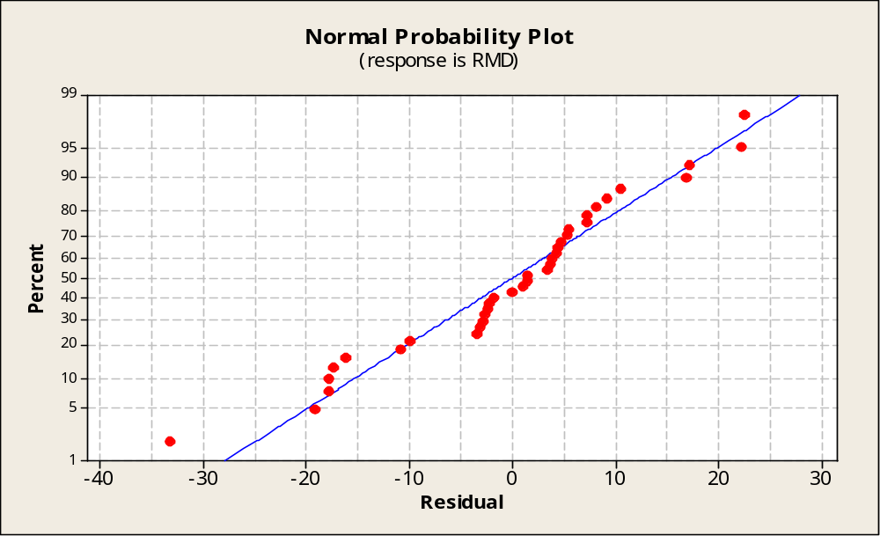
Normal Probability Plot
Graph > Probability Plot > Normal. or ANOVA> GLM: Graphs
Design-Template 14 <number>
Notes:
Based on the normal probability plot, the data is spread along a linear line. No outliners to evaluate. The data looks normal and is sufficient to continue for further analysis.

Slide 5
OneWay ANOVA (Mortars)
One-way ANOVA: RMD versus Mortar
Source DF SS MS F P
Mortar 5 3833 767 3.58 0.012
Error 30 6418 214
Total 35 10251
S = 14.63 R-Sq = 37.39% R-Sq(adj) = 26.96%
Individual 95% CIs For Mean Based on Pooled StDev
Level N Mean StDev --+---------+---------+---------+-------
D-10 6 116.32 17.23 (--------*-------)
D-10+ 6 92.04 14.78 (-------*-------)
F-50 6 99.86 14.73 (--------*-------)
F-50+ 6 94.05 20.65 (-------*-------)
Q-25 6 106.68 10.40 (-------*-------)
Q-25+ 6 84.64 4.13 (-------*--------)
--+---------+---------+---------+-------
75 90 105 120
Pooled StDev = 14.63
Design-Example 13 <number>
Notes:
The One Way ANOVA RMD vs Mortar tells us that there is a 99% confidence that there is at least one Mortar is significantly different. Based on the confidence intervals, the D-10 is significantly different from the D-10+ since the confidence intervals do not intersect.

Slide 6
ANOVA GLM (Primary Factors)
General Linear Model: RMD versus Mortar, Range, Site
Factor Type Levels Values
Mortar fixed 6 D-10, D-10+, F-50, F-50+, Q-25, Q-25+
Range fixed 3 3000, 5000, 7000
Site fixed 2 D, M
Analysis of Variance for RMD, using Adjusted SS for Tests
Source DF Seq SS Adj SS Adj MS F P
Mortar 5 3833.2 3833.2 766.6 4.11 0.007
Range 2 711.1 711.1 355.5 1.91 0.168
Site 1 668.4 668.4 668.4 3.58 0.069
Error 27 5038.8 5038.8 186.6
Total 35 10251.5
Design-Template 14 <number>
Notes:
We have included other factors for this analysis. This test will tell us whether there is significance in Range or Site. The P-Value for the Range and Site indicate that they are significant.

Slide 7
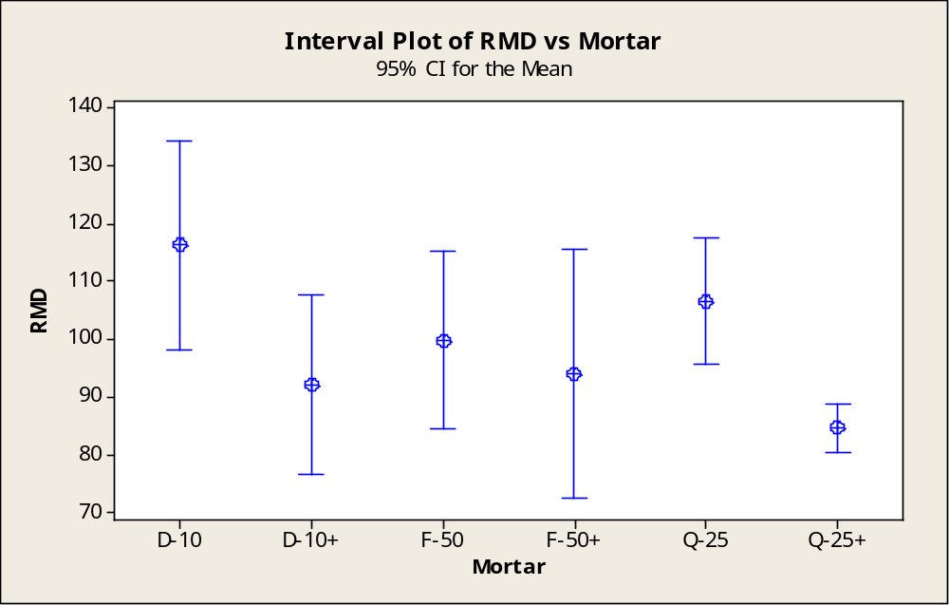
95% Confidence Intervals for Mortars
Stat > ANOVA> Interval Plot
Design-Template 14 <number>
Notes:
This slide shows the means of the confidence intervals. The Q-25+ does not overlap with the Q-25 nor D-10, therefore they are statistically significant. So far, the Q-25+ is looking like it is better than the current system. According to this plot, only the F-50+, F-50, Q-25+ and D-10+ are meeting the spec. The D-10 is the worst system.

Slide 8
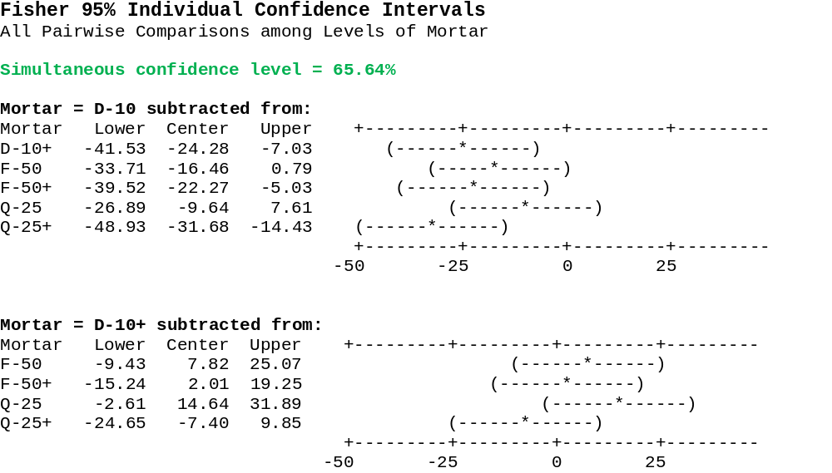
Fisher LSD Comparison
STAT > ANOVA > OneWay > Comparisons > Fisher’s (.05)
Design-Template 14 <number>
Notes:
The Simultaneous Confidence Level is 65.64%. We have a 34% chance of incorrectly identifying a difference when it is not there. For the mortars and modifications that have Confidence Intervals that include 0, they are not significant. The D-10+, F-50+ and Q-25+ are significant.

Slide 9
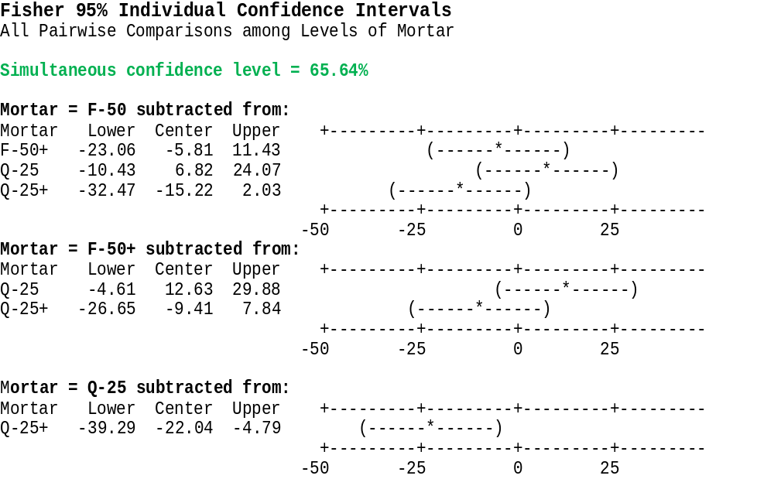
Fisher LSD Comparison
STAT > ANOVA > OneWay > Comparisons > Fisher’s (.05)
Design-Template 14 <number>
Notes:
The Simultaneous Confidence Level is 65.64%. We have a 34% chance of incorrectly identifying a difference when it is not there. For the mortars and modifications that have Confidence Intervals that include 0, they are not significant. The Q-25+ is significant.

Slide 10
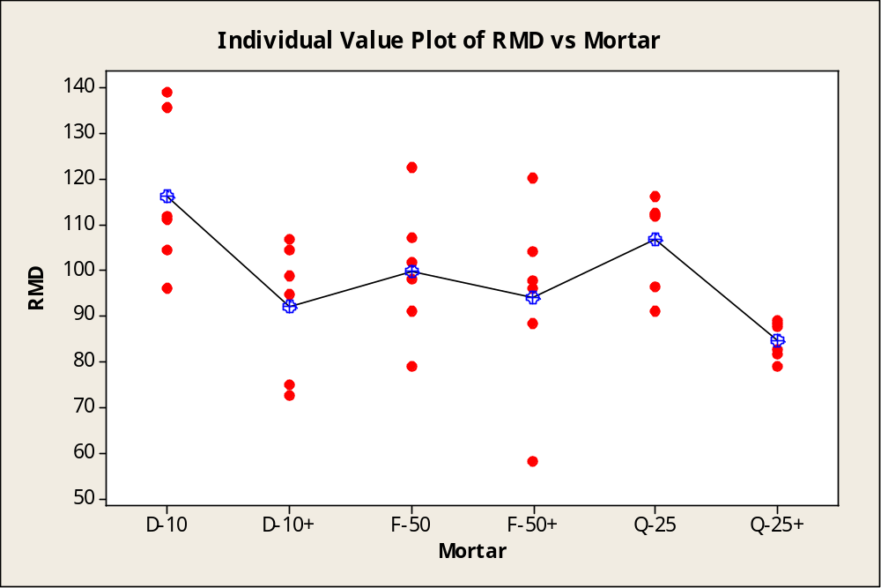
Data Plot (Mortars/Mods)
STAT > ANOVA > Individual Value Plot
Design-Template 14 <number>
Notes:
The data plot shows a relatively wide range source of variability for each mortar. F-50+ has one outliner. D-10 has the highest mean whereas the Q-25+ has the lowest mean but its data points are closely plotted together. According to the Cookie Cutter Method, the Q-25+ is showing the best results for all of its data is appears to meet the requirement of RMD<=100.

Slide 11
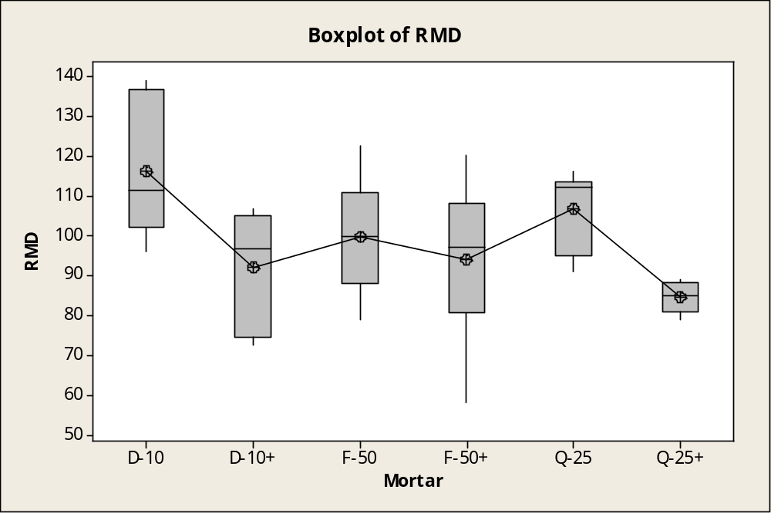
Box Plot Mortars
STAT > ANOVA > OneWay > Graphs > Box Plot
Design-Template 14 <number>
Notes:
To eliminate or not eliminate the Fire Control:
As we see from the boxplots, the Fire Controls modifications for the D-10, F-50 and Q-25 all worked. The means from the D-10+, F-50+ and Q-25+ suggests that the user will get significant gains from a Fire Control modification. Although the D-10+ modification shows the biggest gain, the Q-25+ is still the better mod for all of its data points meet within the spec <=100.

Slide 12
Kruskal-Wallis Test on Mortars
Stat > Non-Parametrics > Kruskal-Wallis
Kruskal-Wallis Test: RMD versus Mortar
Kruskal-Wallis Test on RMD
Mortar N Median Ave Rank Z
D-10 6 111.48 27.6 2.31
D-10+ 6 96.72 14.6 -1.00
F-50 6 99.82 19.6 0.28
F-50+ 6 96.96 16.5 -0.51
Q-25 6 112.08 25.1 1.68
Q-25+ 6 85.08 7.7 -2.76
Overall 36 18.5
H = 14.26 DF = 5 P = 0.014
H = 14.26 DF = 5 P = 0.014 (adjusted for ties)
Design-Template 14 <number>
Notes:
The Kruskal Wallis Tests calculates the average rank for the mortars. The P-Value indicates that there is a 99% confidence that at least one median is different. There is no need to continue this analysis with a pairwise comparison.

Slide 13
Example: Pk T-Stat (1-sample)
Confidence for Pk Rqmt of < 100 (All on this slide)
(Stat>Basic Statistics>1 Sample t: > Options: Less Than)
One-Sample T: F-50+, Q-25, F-50, Q-25+, D-10, D-10+
Test of mu = 100 vs < 100
95% Upper
Variable N Mean StDev SE Mean Bound T P
F-50+ 6 94.05 20.65 8.43 111.03 -0.71 0.256
Q-25 6 106.68 10.40 4.25 115.24 1.57 0.912
F-50 6 99.86 14.73 6.01 111.98 -0.02 0.491
Q-25+ 6 84.64 4.13 1.69 88.04 -9.10 0.000
D-10 6 116.32 17.23 7.03 130.49 2.32 0.966
D-10+ 6 92.00 14.83 6.05 104.20 -1.32 0.122
Design-Example 14 <number>
Notes:
A Radial Miss Distance that is less than or equal to 100m is considered a kill. The average Pk was tested against the 100 to see how confident that we meet the <= specification. The F-50/F-50+, Q-25+ and D10+ meet within the spec. Out of the four systems that meet the specification, we are 100% confident with the Q-25+ and it also has the smallest Radial Miss Distance and that it meets within the spec.

Slide 14
Pk Confidence Level for Proportions
(Stat>Basic Statistics>1 Proportion: Options: Exact Binomial) (show 3)
Test and CI for One Proportion
Q-25 Test of p = 0.7 vs p > 0.7
95% Lower Exact
Sample X N Sample p Bound P-Value
1 2 6 0.333333 0.062850 0.989
Q-25+ Test of p = 0.7 vs p > 0.7
95% Lower Exact
Sample X N Sample p Bound P-Value
1 6 6 1.000000 0.606962 0.118
Design-Template 14 <number>
Notes:
The 1-Proportions tests tells us whether the system or its Fire Control modification can meet within the specification of meeting the Pk >= 0.7. How confident are we? The Q-25 has an efficiency of 33% (hitting 2 out of 6 shots). We’re not confident at all in the Q-25. The Q-25+ has a 100% efficiency hitting 6 out of 6 shots. We are the most confident in the Q-25+ (88.2%).
*Continue next slide

Slide 15
Pk Confidence Level for Proportions Cont..
(Stat>Basic Statistics>1 Proportion: Options: Exact Binomial) (show 3)
Test and CI for One Proportion
F-50 Test of p = 0.7 vs p > 0.7
95% Lower Exact
Sample X N Sample p Bound P-Value
1 3 6 0.500000 0.153161 0.930
F-50+ Test of p = 0.7 vs p > 0.7
95% Lower Exact
Sample X N Sample p Bound P-Value
1 4 6 0.666667 0.271338 0.744
Design-Template 14 <number>
Notes:
The F-50 and F50+ do not fare as good as the Q-25+. Although the F-50 accomplished a hit rate of 66%, we’re only 25% confident that it will meet that. The Q-25+ is the best.

Slide 16
Pk Confidence Level for Proportions Cont..
(Stat>Basic Statistics>1 Proportion: Options: Exact Binomial) (show 3)
Test and CI for One Proportion
D-10 Test of p = 0.7 vs p > 0.7
95% Lower Exact
Sample X N Sample p Bound P-Value
1 1 6 0.166667 0.008512 0.99
D-10+ Test of p = 0.7 vs p > 0.7
95% Lower Exact
Sample X N Sample p Bound P-Value
1 5 6 0.833333 0.418197 0.420
Design-Template 14 <number>
Notes:
The D-10 and D-10+ do not fare as good as the Q-25+. The D-10 is the worst. The D-10+ has a good Pk but we’re 58% confident that it will meet that. The Q-25+ is still the best.

Slide 17
Pk - Calculations Summary
(# kills/# shots - Rqmt is Pk > .70)
Mortar/Mod | Kills ( 6 Shots) | Pk Kill % | Conf Level Proportion (Exact Binomial) | Conf Level & Means (T-Stat 1-Sample)
F50 | 3 | 50% | 7% | 51% 99.86
F50+ | 4 | 66% | 25% | 74% 94.05
Q25 | 2 | 33% | 2% | 9% 106.68
Q25+ | 6 | 100% | 88% | 100% 84.64
D-10+ | 5 | 83% | 58% | 88% 92.00
D-10 | 1 | 16% | 1% | 3% 116.32
Design-Template 14 <number>
Notes:
We can conclude from this slide that the Fire Control modifications to each system made some improvements to the Pk. However, the Q-25+ consistently shows the better gains.

Slide 18
2 Sample t Pairwise Comparison
(Stat>Basic Statistics>2 Sample t: Assume Equal Variances)
Two-Sample T-Test and CI: D-10, D-10+
Two-sample T for D-10 vs D-10+
N Mean StDev SE Mean
D-10 6 116.3 17.2 7.0
D-10+ 6 92.0 14.8 6.1
Difference = mu (D-10) - mu (D-10+)
Estimate for difference: 24.32
95% CI for difference: (3.64, 45.00)
T-Test of difference = 0 (vs not =):
T-Value = 2.62 P-Value = 0.026 DF = 10
Both use Pooled StDev = 16.0738
Design-Template 14 <number>
Notes:
Pairwise Comparisons lets us know if the Fire Control on the current system really helped the D-10.
Only the D-10+ meets the specification of a RMD <= 100. This comparison also tells us that we’re 97% confident that the D-10+ is better than the D-10.

Slide 19
2 Sample t Pairwise Comparison
(Stat>Basic Statistics>2 Sample t: Assume Equal Variances)
Two-Sample T-Test and CI: Q-25+, D-10
Two-sample T for Q-25+ vs D-10
N Mean StDev SE Mean
Q-25+ 6 84.64 4.13 1.7
D-10 6 116.3 17.2 7.0
Difference = mu (Q-25+) - mu (D-10)
Estimate for difference: -31.68
95% CI for difference: (-47.79, 15.57)
T-Test of difference = 0 (vs not =):
T-Value = -4.38 P-Value = 0.001 DF = 10
Both use Pooled StDev = 12.526
Design-Template 14 <number>
Notes:
We now compare the best system, the Q-25+ to the current system D-10. The current system mean doesn’t meat the specficiation. We are 100% confident that the Q-25+ is better than the D-10.

Slide 20
2 Sample t Pairwise Comparison
(Stat>Basic Statistics>2 Sample t: Assume Equal Variances)
Two-Sample T-Test and CI: D-10+, Q-25+
Two-sample T for D-10+ vs Q-25+
N Mean StDev SE Mean
D-10+ 6 92.0 14.8 6.1
Q-25+ 6 84.64 4.13 1.7
Difference = mu (D-10+) - mu (Q-25+)
Estimate for difference: 7.36
95% CI for difference: (-6.65, 21.37)
T-Test of difference = 0 (vs not =):
T-Value = 1.17 P-Value = 0.269 DF = 10
Both use Pooled StDev = 10.8869
Design-Template 14 <number>
Notes:
We now compare the two best systems the D-10+ and the Q-25+. We are 73% confident that the Q-25+ is better.

Slide 21
ANOVA with Factor Interactions
STAT > ANOVA > General Linear Model with Interactions
(Use (*) between factors for Interactions)
Analysis of Variance for RMD, using Adjusted SS for Tests
Source DF Seq SS Adj SS Adj MS F P
Mortar 5 3833.2 3833.2 766.6 5.07 0.010
Range 2 711.1 711.1 355.5 2.35 0.138
Site 1 668.4 668.4 668.4 4.42 0.057
Mortar*Range 10 2555.8 2555.8 255.6 1.69 0.193
Mortar*Site 5 667.6 667.6 133.5 0.88 0.522
Error 12 1815.5 1815.5 151.3
Total 35 10251.5
Design-Template 14 <number>
Notes:
Based on the results from the ANOVA with Factor Interactions, there is a 81% confidence that there is an interaction between Mortar and Range. The Mortar and Site interaction is not as confident with an 48% confidence level. There is not enough data to determine which interactions are critical at this point.

Slide 22
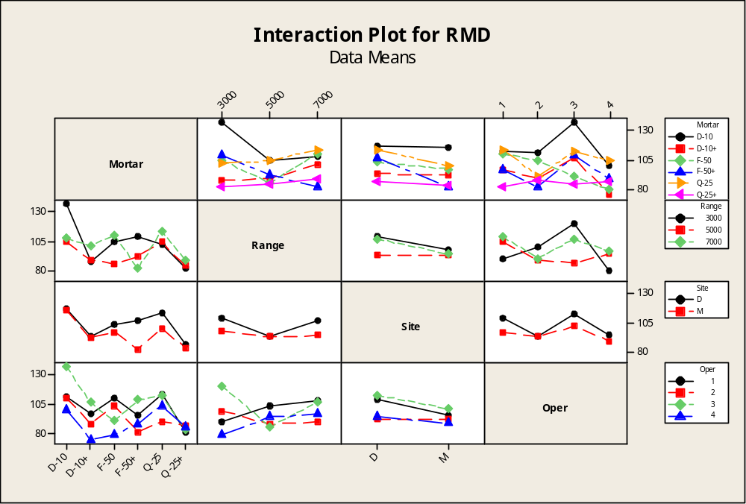
Interaction Plots Including Operator
STAT > ANOVA > Interaction Plot (All Factors)
Design-Template 14 <number>
Notes:
From the Interaction Plots we can conclude that the Q-25+ is the best for short range followed by the D-10+. For Long range the F-50+ is the best followed by the Q-25+.
The Q-25+ shows a consistency in its effectively for it is the best system between the Desert and the Mountains. The D-10 is consistent with being the worst in both sites.
For Operators, we were to test all combinations. Each Operator was able to utilize the Q-25+ pretty well. The stability in the data suggests that each operator was able to get a good shot off. On average, Operator 3 had the hardest time with all most of the systems i.e. Q-25, F-50+, D-10 and D-10+. Operator 4 generally had the best shots with each system that leads us to believe Operator 4 was the most skillful.

Slide 23

One-Way ANOVA for Operators
One-way ANOVA: RMD versus Operator
Source DF SS MS F P
Oper 3 1720 573 2.15 0.113
Error 32 8531 267
Total 35 10251
S = 16.33 R-Sq = 16.78% R-Sq(adj) = 8.98%
Individual 95% CIs For Mean Based on Pooled StDev
Level N Mean StDev +---------+---------+---------+---------
1 9 103.53 12.93 (-----------*----------)
2 9 92.99 17.75 (----------*----------)
3 9 107.78 20.96 (----------*----------)
4 9 91.43 12.04 (----------*-----------)
+---------+---------+---------+---------
80 90 100 110
Design-Template 14 <number>
Notes:
This chart is about One Way on Operators. Operators were not a major factor for this design project. The P value tells us that 89% confidence that at least one operator is significant. The horizontal Pooled StDev shows that each operators overlap which indicates that they are not statistically significant. Operator 4 was the best whereas Operator 3 may be the least experienced.

Slide 24
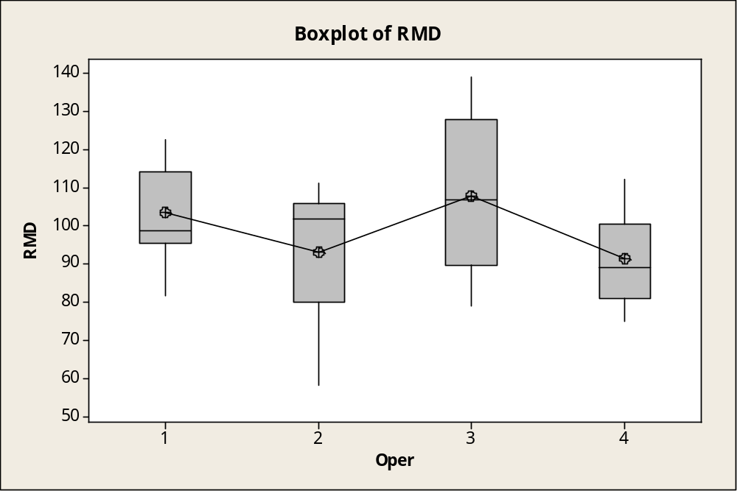
Boxplot of Operators
Stat > ANOVA> One-way: Graphs: Boxplot:
Design-Template 14 <number>
Notes:
From a median and a mean point of view, Operator 4 is the best. Based on the data from the One-Way ANOVA for Operators, we are 89% confident that Operator 4 is better than Operator 2 and Operator 3 is the worst. Neither operator is statistically significant from another.

Slide 25
Conclusion/Insights
Data is assessed to be normal
ANOVA Results at least one Mortar/Mod is significantly different
Ranges and Sites are significantly different
Confidence Intervals and Fishers LSD indicate (with 34% error):
  F-50, F-50+ and Q-25+ are significantly better than the Q-25
BoxPlots (Mortars) – At least one Mortar/Mod is Significantly Different.
  Medians of F-50+ and D-10+ are about the same
  Data Points for Q-25+ are relatively close
  Q-25+ is statistically different from Q-25, F-50 and D-10
BoxPlots (Operators) – All Operators are statistically the same
    Medians of 3 and 2 are close
Interactions for Mortar/Site (81%) and Mortar/Range (48%)
  Q-25+ and D-10+ are about the same at each site and from 3000m
  F-50 is the better system from the critical distance of 7000m
  Each operator consistently had good results with the Q-25+
Probability of Kill:
  Q-25+ 6 of 6, D-10+ 5 of 6, F-50+ 4 of 6, F-50 3 of 6, Q-25 2 of 6, D-10 1 of 6
  Confidence in the Q-25+ and D-10+ meeting the Pk requirement (100% & 88%)
  Only statistically confident in the Q-25+ meeting Pk with exact binomial (88%)
Operator Influence: Not significantly different. Operators 2 and 4 are the most skillful. Operator 4 appears to a little be better.
Design-Template 14 <number>

Slide 26
Recommendations
Eliminate F-50 F-50+ from the competition
Continue tests and development with Q-25+ and D-10+
Design-Template 14 <number>

